Slide 1
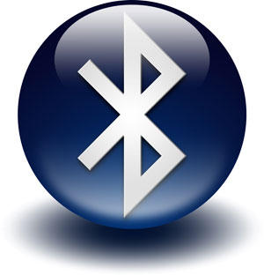
Bluetooth
Created By:-
Nisarg Dave(14MCA12)
Harsh Mistry(14MCA20)

Slide 2
What is Bluetooth Technology????
Bluetooth is a way of exchanging data wirelessly over short distances, and is an attempt to eradicate wires.
Using a radio frequency to transmit data, it creates a short range network.
Secure
Can connect up to eight devices (items of electronic equipment) at the same time.
The chip can be plugged into items such as computers, digital cameras, mobile phones and faxes.

Slide 3
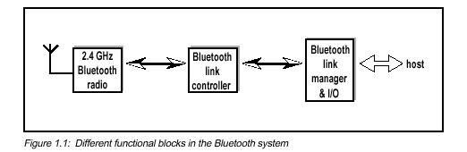
How does the Bluetooth Technology Works?????
When one Bluetooth product comes within range of another, (this can be set to between 10cm and 100m) they automatically exchange address and capability details
They can then establish a 1 megabit/s link (up to 2 Mbps in the second generation of the technology) with security and error correction, to use as required. The protocols will handle both voice and data, with a very flexible network topography.

Slide 4
Each device has a unique 48-bit address(MAC Address) from the IEEE 802 standard. Connections can be point-to-point or multipoint.
Simple steps for exchange:
1) When two Bluetooth enabled devices connect to each other, this is called pairing.
2) After the pairing the device the communication line is establish.
3) Sender and receiver is ready to communicate and transfer the data.
4 ) After the communication is over the communication line is disable it mean the pair of the Bluetooth device is disconnected.
Data exchange can be in two ways:
Full Duplex
Half or Part Duplex

Slide 5
Full Duplex:
Data can be sent and received simultaneously without any distraction in the network.
e.g Mobile Phones, Broadband internet
Half Duplex:
Data can be either sent or received at a single point of time, but operations cannot take place.
e.g Walkie talkie

Slide 6
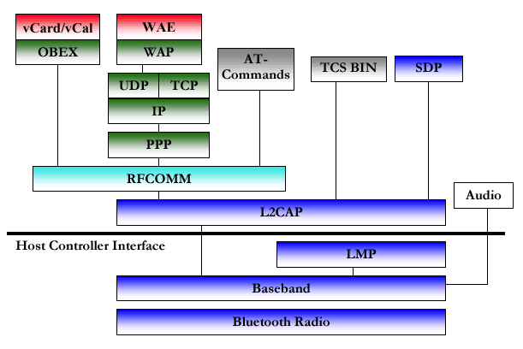
Bluetooth Protocol Stack

Slide 7
1. Bluetooth Core Protocols
Baseband:- Enables physical link between devices.
i) Synchronous Connection-Oriented is used for the send data like audio and video and
ii) Asynchronous Connection-Oriented is used to send the simple data like file and images etc.
II Link Manager Protocol:- Responsible for creating a link between devices.
Also responsible for security and encryption between the devices.
Logical Link Control And Adaptation Protocol:- This protocol is give the upper link of the LMP. This protocol provides the connection-Oriented and connectionless data services.
Service Discovery Protocol:- This protocol is used for device information and the characteristics of the service can be queried after that.

Slide 8
2. Cable Replacement Protocol
RFCOMM:- RFCOMM is serial line emulation protocol.
This protocol is used against the concept of the cable wires.
This protocol is used for the data signals over bluetooth baseband providing the transport capabilities between the devices.

Slide 9
3. Telephony Control Protocol
Telephony Control – Binary:- Defines the call control signal for speech and data calls between the bluetooth devices.
This protocol is used for the phone call or voice transfer between the bluetooth devices.
Telephony Control – AT Commands:- Bluetooth Special Development Group has define the set of the commands. Using this commands the Mobile Phone and other modem can be control. For example the FAX Services are used of the commands like FAX class 1.0 and FAX Class 2 etc.

Slide 10
4. Adopted Protocol
PPP:- PPP stand for the Point-to-Point Connection. Point to Point mean at time one bluetooth device is connected with only one device. Because of point to point connection establish most of the time data transfer is done using half-duplex service.
TCP/IP:- This protocol standards are defined the internet engineering task force and used for communication across the internet. Printer, Handheld computer and Mobile are used socket programming to communicate with the OS. To implement these standards in bluetooth device allow to communicate these device using the internet.
OBEX:- Object Exchange Protocol
Defines a folder-listing object.
Used to browse the content of folder on remote device.
Shows all possible file to exchange using the bluetooth.

Slide 11
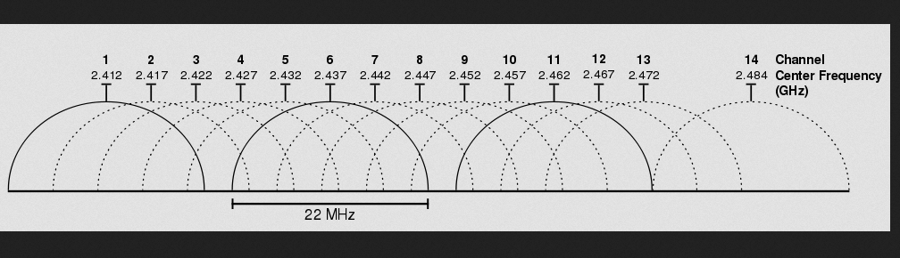
IV)
WAP:- WAP is stands for wireless Application Protocol that works across a variety of wide-area network technologies. The main goal is to bring these protocol is internet content and telephony service to digital cellular phones and other wireless terminals
Channel

Slide 12
Comparison Chart
Bluetooth Version | 1.2 | 2.0 | 3.0 | 4.0
Data Transmission Rate | 721 Kbit / s | 3 Mbit /s | 24 Mbit /s | Equivalent or above 24 Mbit /s
Security | No | No | Nominal | Yes
Backward Compatibility | Yes (1.0) | Yes (1.2) | Yes (2.0 & 2.1) | Yes (3.0)

Slide 13
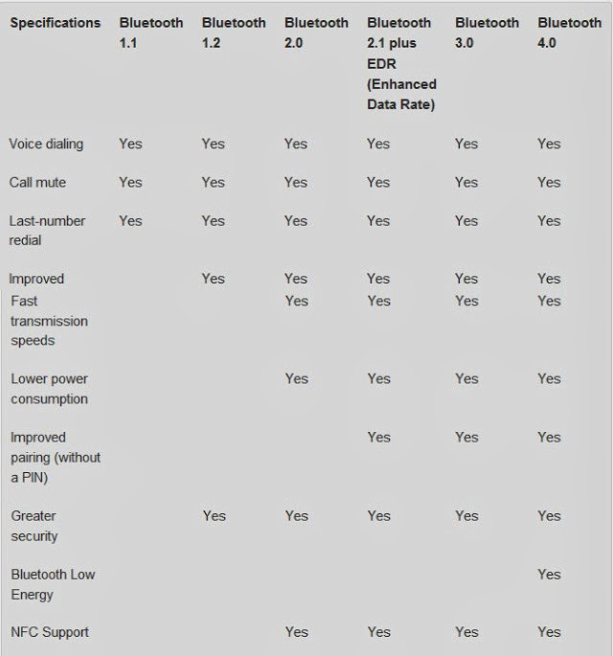

Slide 14
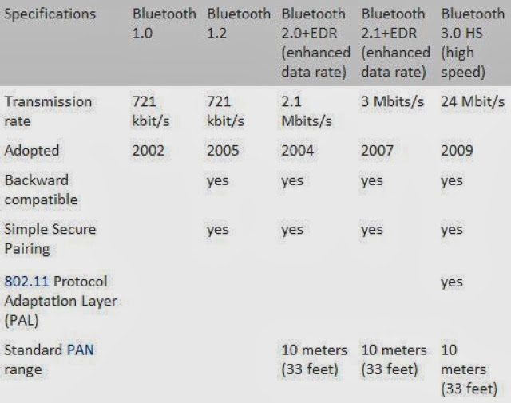

Slide 15
Thank You ☺

Slide 16
References
http://www.digitaltrends.com/mobile/how-does-bluetooth-work/
http://electronics.howstuffworks.com/bluetooth.htm
http://srohit.tripod.com/bluetooth_sec.pdf
http://bluetoothreport.com/bluetooth-versions-comparison-whats-the-difference-between-the-versions/
http://wistao.blogspot.in/2012/09/comparison-of-bluetooth-different.html

